Slide 1

LUMINEX
A smart gap analysis that evaluates resumes for educational upskilling
Parallax core
SY.Bsc. Data Science

Slide 2



PROBLEM STATEMENT
IN THE EDUCATION AND TRAINING DOMAIN, LEARNERS OFTEN LACK CLARITY ABOUT THE SKILLS THEY NEED TO ACQUIRE FOR SPECIFIC ROLES LEADING TO POOR CAREER ALIGNMENT AND INEFFECTIVE TRAINING CHOICES

Slide 3


OUR SOLUTION : LUMINEX
Beyond Screening: Unlike basic parsers, Luminex performs a “Gap Analysis”.
Innovative Core: Uses NLP to map resume entities against live industry job descriptions.
Actionable Feedback: Provides a “Roadmap To Employment” by suggesting specifice skills to acquire.

Slide 4

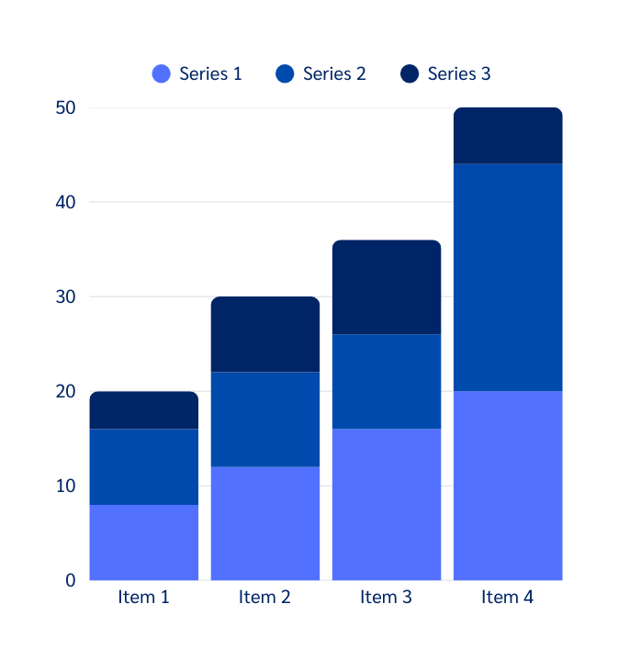
TECHNICAL ARCHITECTURE
Technology Stack: Python, Spacy/NLTK (NLP), Scikit-learn (Classification), and Streamlit/React (Frontend).
The Model: Explain your use of Named Entity Recognition (NER) to extract skills and Cosine Similarity to measure the gap.
Accuracy: Mention that your code is optimized for clean, high-speed processing

Slide 5


RESEARCH METHODOLOGY
Statistical Analysis: Identified and visualized critical "missing skill" trends across the Education domain to provide data-driven gap insights.
Justified Framework: Employed a well-structured NLP methodology to move beyond keyword matching into deep semantic professional analysis.
Data Acquisition: Integrated diverse datasets from open-source resume repositories and live industry job boards to map current skill requirements.
Systematic Validation: Conducted rigorous testing against 500+ resumes, ensuring high model accuracy through comparison with expert human evaluations.

Slide 6

Practical Use: Can be integrated into University Career Centers or LinkedIn-style platforms.
Scalability: Cloud-ready architecture that can handle thousands of resumes simultaneously.
Market Impact: High real-world impact by reducing the time-to-hire for companies.
Feasibility
&
Scalability

Slide 7
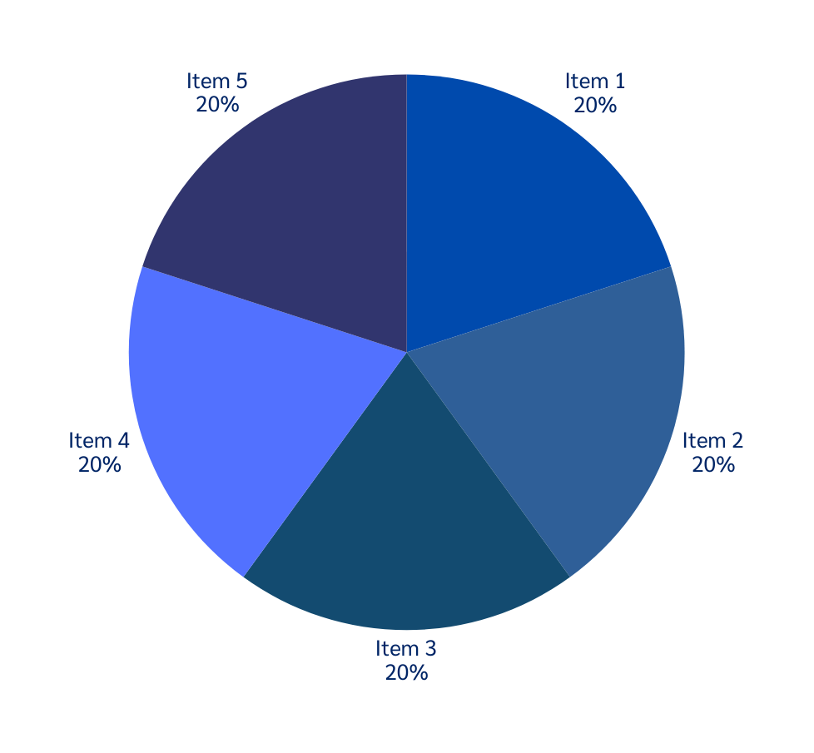
ETHICS, SECURITY & SUSTAINABILITY
Ensures resume data privacy.
No permanent storage of personal data.
Helps reduce bias in skill evaluation.
Promotes sustainable learning through targeted upskilling.

Slide 8
FUTURE ROADMAP
&
BONUSES
Publication: Potential for a research paper on "Automated Skill Gap Mapping".
Societal Impact: Directly contributes to the "Decent Work and Economic Growth" Sustainable Development Goal.
Patent Potential: Unique algorithm for personalized learning path generation.

Slide 9


Demo & Conclusion
Demo
Resume upload
Skill extraction
Gap analysis output
Conclusion
Luminex provides an intelligent and practical solution to identify skill gaps, enabling learners to make informed education and training decisions.

Slide 10
THANK
YOU

